Slide 1
Fine Tuning and Christian Faith Review and Observations by David Seuss February 2021

Slide 2
Rational arguments for the existence of God that do not depend on scriptural inerrancy or personal revelation
Human consciousness
The mathematical structure of the universe and our ability to understand it
Human conscience
Human longing for purpose
The appreciation of beauty
Free will
Quantum mechanics
Fine tuning

Slide 3
Discussion questions to keep in mind during the presentation
How important is the origin and evolution of the physical universe to any aspect of your faith?
Many Christians take comfort in the fine-tuning argument, others don’t really care.
Where do you come out?
Are you concerned at all about the nature and content of the popular media discourse on cosmic origins which is universally hostile to theism?
Many Christian apologetic leaders feel that fine tuning addresses the public impression that scientifically based atheism explains everything in terms of cosmic origins.
Is this public discourse on fine tuning important and are the apologetics’ arguments convincing?
Should Christian leaders take such a stand in favor of fine tuning?

Slide 4
The reason we care about fine tuning, as expressed by that most modern of American philosophers: Brandi Carlile
Have you ever stared into a starry sky? Lying on your back you're asking why What's the purpose I wonder who am I If you've ever stared into a starry sky
https://youtu.be/FkxyT27xRH0

Slide 5
What fine tuning is and is not
Fine tuning discusses what combination of the physical constants in our universe would create conditions allowing intelligent life in any form to evolve, and how probable it is that the constants will have these values if the process to select them is a random event in the Big Bang
Usually, commentators focus on the issue of conditions that permit matter to form, chemistry to exist, and third generation stars to have long lives (so that elements heavier than helium could form)
Note what a high bar the above criteria establishes; intelligent life that is very different from ours could evolve in other conditions, (e.g., silicon based instead of carbon based), but such alternative life forms would still require matter, chemistry, and third generation long-lived stars
A related set of ideas is how probable life on a planet like Earth is given things like cosmic hazards (this is the “Rare Earth Hypothesis” of Ward and Brownlee), how probable complex life is, and whether evolution alone could produce human-level intelligent beings
But those questions are not part of the fine-tuning debate

Slide 6
In the beginning, God said, “Let there be fine tuning,” and there was life.
1802
William Paley and watch/watchmaker analogy
1913
Chemist Lawrence Henderson wrote The Fitness of the Environment pointing out that life depends entirely on the very specific environmental conditions on earth, especially regarding the prevalence and properties of water
1961
Physicist Robert Dickie, the Albert Einstein Professor at Princeton, observed that gravity and electromagnetism must be perfectly “fine tuned” for life to exist

Slide 7
Since Robert Dickey coined the phrase and suggested cosmological implications, fine tuning has attracted more and more serious scientific interest

Slide 8
Calculations, proofs, laws, and constants
An example of a calculation would be: 1 + 2 = 3
This statement is presumed true in all possible universes
A example of a mathematical proof would be: area of a circle = pi x radius^
Mathematical proofs start with axioms that are given as true and the conclusion is logically proved to be necessarily true given the axioms
Proofs are not part of the fine-tuning debate as their logic would be true in all universes given the same set of axioms
An example of a physical law would be: E = mc^2
There may be universes where E = mc^3, but in this one we know that it is the speed of light squared and not cubed
These other universes are part of the multiverse discussion which comes later
And that brings us to the constants, which are the subject of the fine-tuning debate …

Slide 9
What is a constant?
A constant in physics is a number that must be added “by hand” to an equation to make it conform to experimental outcome or which is a physically measured quantity
Constants are not determined by any fundamental physical law
They cannot be derived or calculated from theory
They just are what they are
A classic example of added by hand would the Cosmological Constant that Einstein kept adding in and taking out of General Relativity to make it conform to changing observations about the expansion of the universe
In E = mc^2, the physical constant is c, the speed of light in a vacuum

Slide 10
Some of the physical constants of the universe
speed of light in vacuum
Planck constant
reduced Planck constant
Newtonian constant of gravitation
vacuum electric permittivity
vacuum magnetic permeability
characteristic impedance of vacuum
elementary charge
Avogadro constant
Boltzmann constant
conductance quantum
Josephson constant
von Klitzing constant
magnetic flux quantum
inverse conductance quantum
Bohr magneton
nuclear magneton
fine-structure constant
inverse fine-structure constant
electron mass
proton mass
neutron mass
Bohr radius
classical electron radius
electron g-factor
Fermi coupling constant
Hartree energy
quantum of circulation
Rydberg constant
Thomson cross section
weak mixing angle
atomic mass constant
Faraday constant
molar gas constant
molar mass constant
Stefan–Boltzmann constant
first radiation constant
first radiation constant for spectral radiance
molar mass of carbon-12
molar Planck constant
second radiation constant
Wien wavelength displacement law constant
Wien frequency displacement law constant
Wien entropy displacement law constant
Ratio of electromagnetic force to gravity
Expansion rate of the universe
Mass density of the universe
Cosmological Constant
Higgs particle mass
hyperfine transition frequency of 133Cs
Ratios of any of the above
Ratio of electrons to protons
W and Z mass ratio

Slide 11
The core proposition, Part I
For intelligent life to exist, matter, chemistry, and long-lived third-generation stars must be permitted by the local laws of physics
This plays out in a discussion of the constants in the laws which it turns out fundamentally impact the above outcomes
The Standard Model of particle physics, General Relativity, and Quantum Mechanics are used to evaluate the alternative values to predict how changing the constant values would impact the ability of matter, chemistry, and long-lived third generation stars to exist
The values of the physical constants of our universe that work to permit matter, chemistry, and long-lived third-generation stars are infinitesimally small compared to their potential “natural” ranges

Slide 12
What happens when you move outside the life permitting range of the constants?
Bad things such as
Particles never form and the universe is just energy
Matter forms, but not atoms, prohibiting chemistry and material organization of any type
The entire Universe collapses into a gigantic black hole soon after its big bang or expands so fast no galaxies ever form which means no stars ever form
Stars collapse into black holes shortly after they are formed, no second and third generation stars ever form
Stars burn out so fast, in less than 10 million years, life can’t get started or have time to evolve
Stars never develop the ability to make the heavier elements of carbon or other higher atomic weights (e.g., oxygen, silicon), remaining a mostly hydrogen/helium universe

Slide 13
Example of how just a few constants can shape the universe (and how fined tuned they are)
Various writers select from the list on the earlier slide on the contents and do their fine-tuning analyses
Five constants cited below are the ones discussed and modeled by physicist Victor Stenger as described later in this presentation
The probability of a particular constant being randomly set to a life permitting value is expressed as a fraction
The fractions are reported by Victor Stenger and attributed to various Christian apologists including Rich Deem and Hugh Ross
The five key constants and the apologists claimed probabilities that they fall within a life permitting are:
Ratio of electrons to protons (1/10^37)
Ratio of electromagnetic force to gravity (1/10^40)
Expansion rate of the universe (1/10^55)
Mass density of the universe (1/10^55)
Cosmological Constant (1/10^120)
Combined probability of all five being achieved in one creation event where the values are chosen randomly:
1/10^307, which is an incredibly small probability

Slide 14
Naturalness
To calculate a fraction, you must have a numerator and a denominator
The numerator in the fine-tuning debate is the life permitting range of the constant and the literature implies that it is relatively straight forward for a physicist to calculate the impact of different constant values
But what is the denominator for the range of values a constant might take if not fine tuned?
The denominator is usually taken to be the “natural range” of values for the constant that will not break the Standard Model, General Relativity, Quantum Mechanics, or some fundamental concept like Plank Scale for energy, length, or time

Slide 15
The natural range of constants impacts the probabilities
Each analysis of a constant's natural range must be specifically reasoned, but such reasoning appears doable by the physicists on both sides of the fine-tuning debate
For example, physicist Luke Barnes in his paper “The Fine Tuning of the Universe for Intelligent Life” describes a parameter space concerning fermions acquiring mass from Higgs particles affecting the mass of up and down quarks
The analysis was based on a parameter space range that can’t be larger than a relevant Planck Scale or smaller than would break QCD (part of Quantum Mechanics)
Any value between those is presumed to be possible, which in this specific case yielded a “natural "range of 60 orders of magnitude
The Stanford Encyclopedia Fine Tuning discussion of naturalness uses a similar analysis for two examples (in this case the Higgs mass and the Cosmological Constant) involving Planck Scale and the Standard Model

Slide 16
Most physicists agree that the values of the constants in our universe are finely tuned
Fred Hoyle: “The list of anthropic properties, apparent accidents of a non-biological nature without which carbon-based and hence human life could not exist, is large and impressive.”
Stephen Hawking: "The remarkable fact is that the values of these numbers seem to have been very finely adjusted to make possible the development of life."
Sean Carroll: “It is commonplace in discussions of modern cosmology to assert that the early universe began in a special state. …. I argue that the fine-tuning is real ...”
Paul Davies: "There is now broad agreement among physicists and cosmologists that the Universe is in several respects ‘fine-tuned' for life".
Freeman Dyson: “The more I examine the universe and the details of its architecture, the more evidence I find that the universe in some sense must have known we were coming.”
Roger Penrose: “How special was the big bang?... This now tells us how precise the Creator's aim must have been: namely to an accuracy of one part in 10^10^123.”

Slide 17
How big is 10^10^123 (and therefore how small is 1 divided by that number)?
10^10^123 is probably the biggest number you will ever see in physics short of infinity (and conversely 1/10^10^123 the smallest number you will ever see short of zero)
If you tried to write 10^10^123 out it would be 1 followed by 10^123 zeros
There have been 10^17 (1 followed by 17 zeros) seconds since the Big Bang
If you wrote Penrose’s number at the rate of 1 zero per second you would have to stay on the task for this many “universe lifetimes:”
999,999,999,999,999,999,999,999,999,999,999,999,999,999,999,999,999,999,999,999,999,999,999,999,999,999,999,999,999,999,999,999,999,999,999,999,999,999,999,999,983

Slide 18
Theologians too have much to say on fine tuning
Francis Collins: “The chance that all of these constants would take on the values necessary to result in a stable universe capable of sustaining complex life-forms is almost infinitesimal. And yet those are exactly the parameters that we observe. In sum, our universe is wildly improbable.”
William Lane Craig: “To say that the universe is finely tuned means that the fundamental constants and quantities of nature fall into an extraordinarily narrow range of values that enable embodied, conscious observers to exist. That fact seems to be well-established scientifically.”
Alvin Plantinga: “It's as if there are a large number of dials that have to be tuned to within extremely narrow limits for life to be possible in our universe. It is extremely unlikely that this should happen by chance …”
Hugh Ross: “Fine-tuning is 10 to the 43rd times more exquisite than someone blindfolded, with just one try, randomly picking out a single marked proton from all the protons existing within the entire extent of the observable universe.”

Slide 19
The core proposition, Part II
Before the discovery of the Big Bang, the value of the constants could be taken as eternally existing brute facts
However, with the Big Bang, there was a precise moment of creation when the exact values of the constants came into existence
How were they set?
Physics and cosmology have yet to develop plausible ideas for a process or physical law that explains how the values of the physical constants were fixed
Physicists have often suggested the values of the constants might have been set randomly in the Big Bang singularity
The probability of the values of the constants being what they are by random chance in a single creation event is infinitesimally small, suggesting that a divine creator must have “tinkered with dials” to permit a universe where we could evolve
This last point is where the argument for God from fine tuning enters the debate

Slide 20
The impact of the fine-tuning argument has been profound
Like the discovery of the Big Bang itself, fine tuning became a possibly strong argument for belief in God that appeared to be based in science
Comforting to many Christian's worrying about the relentless expansion of the claims of science including Craig, Plantinga, and Ross, quoted previously, who frequently cited fine tuning in writing and debates
Engages non-believers who claim to base their non-belief on science
Convinced Antony Flew, the leading atheist of the 20th century to become a believer

Slide 21
Antony Flew
Student of C.S. Lewis as an undergraduate but thought Lewis’s reasoning flawed in his book Mere Christianity
Wrote, while Lewis’s student, “Theology and Falsification,” which argued that claims about God were merely vacuous where they could not be tested for truth or falsehood and this publication established his trajectory as a bright star of atheism
Wrote 43 essays, articles and books; 42 of them proposed atheist belief as the only rational world view
Most prominent work includes the 1976 The Presumption of Atheism in which Flew forwarded the proposition that the question of God's existence should begin with the presumption of atheism

Slide 22
Influence of The Presumption of Atheism was enormous
Flew wrote:
"What I want to examine is the contention that the debate about the existence of God should properly begin from the presumption of atheism, that the onus of proof must lie upon the theist.”.
The impact of Flew's proposed negative atheism is illustrated by William Lane Craig's 2007 assessment that the presumption of atheism had become "one of the most commonly proffered justifications of atheism."
BBC journalist William Crawley said in 2010, "The Presumption of Atheism (1976) made the case, now followed by today's new atheism, that atheism should be the ... default position” … and has "no burden of proof… asserting that the burden of proof rests solely on the theist.”

Slide 23
But then between 1999 and 2004, Flew changed his mind and became a believer in God
Stated in letters he wrote in 2001, then leaked the change in 2004 in an interview with an atheist publication, and then that year published There Is a God co-authored with Christian apologist Roy Varghese
Cited advancing science in two areas as his reason: the fine tuning of the universe and the Big Bang
About the former he wrote in a chapter he titled with Freeman Dyson’s quote, “The Universe Knew We Were Coming”
“The recent popularity of this argument has highlighted a new dimension of the laws of nature. … In other words, the laws of nature seem to have been crafted so as to move the universe toward the emergence and sustenance of life ... Let’s take the most basic laws of physics. It has been calculated that if the value of even one of the fundamental constants … had been to the slightest degree different, then no planet capable of permitting the evolution of human life could have formed … Virtually no major scientist today claims that the fine tuning was purely a result of chance factors at work in a single universe.”

Slide 24
A maelstrom of criticism erupts from the atheist community
Feeling betrayed by their elder statesman, the atheist community reacted vehemently and heaped accusations and criticisms onto Flew
Various commentators claimed
Flew was suffering from dementia and the book was really written by Roy Varghese
The book contains arguments that he didn’t know about and didn’t consent to (Richard Carrier’s review: “Flew’s Bogus Book”)
The book uses “Americanisms” in language that would not be natural to an Englishman
Flew didn’t understand the science he was quoting (this from Victor Stenger)
In a later interview, Flew did not know the work of authors he quoted in the book
Flew was frail and suddenly afraid of death; longing for an afterlife overwhelmed him

Slide 25
Flew responds
“I have been denounced by my fellow unbelievers for stupidity, betrayal, senility and everything you can think of and none of them have read a word that I have ever written…
“I have rebutted these criticisms in the following statement: My name is on the book and it represents exactly my opinions. I would not have a book issued in my name that I do not 100 percent agree with. I needed someone to do the actual writing because I’m 84 and that was Roy Varghese’s role. The idea that someone manipulated me because I'm old is exactly wrong. I may be old but it is hard to manipulate me. This is my book and it represents my thinking."

Slide 26
Christian apologists rally to Flew’s support
Biola University awarded him the Phillip E. Johnson Award for Liberty and Truth in 2006 "for his lifelong commitment to free and open inquiry and to standing fast against intolerant assaults on freedom of thought and expression".
When informed of his award, Flew remarked, "In light of my work and publications in this area and the criticism I’ve received for changing my position, I appreciate receiving this award."
William Lane Craig openly defended him in public settings and appearances
Anthony Horvath published letters written to him by Flew between 2001 and 2006 that lay out all the core arguments Flew put forth in There Is a God, refuting the idea that Flew’s new positions were not his alone

Slide 27
Antony Flew: rest in peace
Antony Flew dies in 2010, at the age of 87, and is reported to have been suffering from dementia at the time of his death
The debate then shifted back to the scientists

Slide 28
Three arguments against fine tuning
The analyses of the probabilities are wrong
Future discoveries of a “theory of everything” will reveal a mechanism for setting the values of the constants to what they are
The multiverse

Slide 29
Victor Stenger attacks fine tuning
Professor of physics at the University of Hawaii with a focus on gluons, quarks, strange particles, and neutrinos, and wrote or co-wrote seven peer-reviewed articles over his 36-year career as a physicist
Hmm … not very prolific
Wrote 17 popular books and 33 essays, most challenging religious belief and promoting atheism, including the book God: The Failed Hypothesis – How Science Shows that God Does Not Exist
One of his essays attacked Antony Flew’s grasp of science
In 2011, Stenger writes The Fallacy of Fine Tuning in which he mounts an all-out assault on fine tuning in general and Hugh Ross’s formulation of the probabilities in particular

Slide 30
The Fallacy of Fine Tuning
One of Stenger’s main proposition is that commentators failed to consider combinations of the constants where a change in one offset a change in one or more of the others
He thought the range of the natural values in the denominators were too wide and suggested a range of two to ten orders of magnitude
Built the MonkeyGod software model which is a tool for building “toy universes” with different values of the constants and seeing if they result in life permitting universes using one condition for judging whether the resulting universe would permit life: whether long-lived stars would be possible
Published MonkeyGod on an open website* for anyone to try, and used it to simulate different combinations of the five constants
“We have seen that the proponents of fine-tuning make serious errors in physics, cosmology, probability theory, and data analysis. While not every proponent makes every error, there is a remarkable similarity to the arguments you find in the theist literature, which leads you to suspect that they do not do much research to support their claims beyond simply reading each other's books.”
*Sadly, discontinued with Stenger’s death

Slide 31
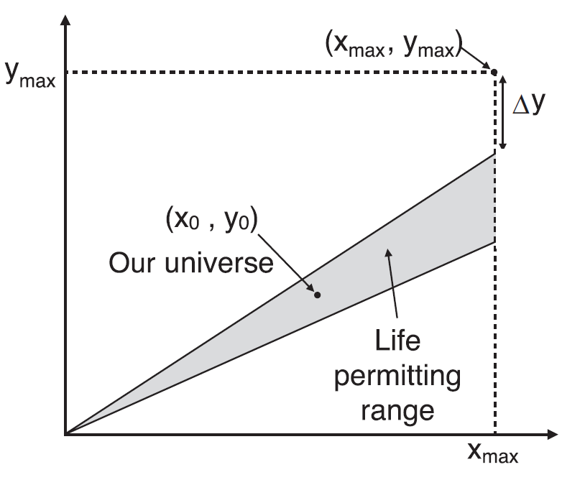
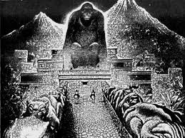
Stenger runs his MonkeyGod simulations and produces the famous “Wedge”
“Using a sample of 10,000 universes, I have estimated the fraction of universes generated that should have properties that allow for some form of life not too drastically different from our own.”
In this example, varying one parameter at a time moves out of the life permitting range quickly, but varying both parameters together allows the simulated universe to move up and down along the slope of the “wedge” staying in the life permitting region for much longer over the parameter space.

Slide 32
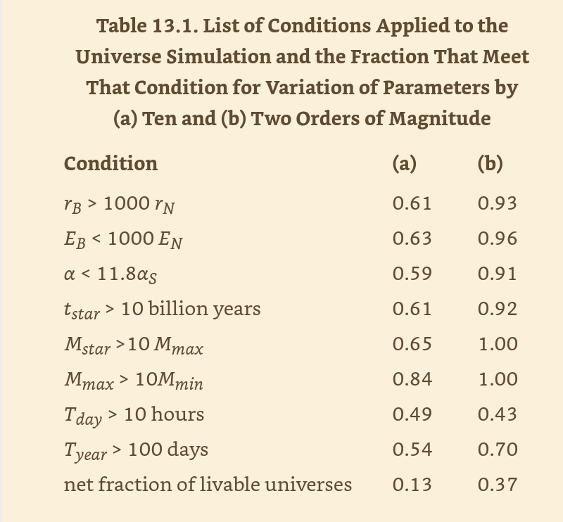
Stenger concludes that between 13% and 37% of randomly selected values for the physical constants will produce life-sustaining universes based on stellar lifetimes as the criteria – calculations fatal to fine tuning if the reasoning is well -founded
This analysis has leaked into the popular mindset. I have heard both apologists and skeptics state the idea that if more than one of the physical constants are varied in concert with each other then the assertion that fine tuning is improbable fails.

Slide 33
Enter Luke Barnes, the game changer
Lecturer and post doctorate researcher in physics and cosmology at Western Sydney University
First in a series of posts to his blog, then in a journal-published paper that reviews The Fallacy of Fine Tuning, then in his book A Fortunate Universe: Life in a Finely Tuned Cosmos, Barnes challenges Victor Stenger’s methods and the accuracy of the MonkeyGod model
Unlike Craig, Wright, Plantinga, Ross, and Collins, Barnes is a physicist that can engage the scientific experts with equal training, knowledge, and mathematical ability
His basic argument regarding the correlation of constants in MonkeyGod is that Stenger only considers one outcome of the co-varied constants: the lifetime of stars
Barnes argues that any set of changes must be evaluated against all the outcomes that could all be potentially disastrous for intelligent life, not just one
In effect, Barnes turns Stenger’s method on itself: Stenger complained that apologists only varied one constant at at time; Barnes complains that Stenger only evaluated one resulting life-permitting condition at a time

Slide 34
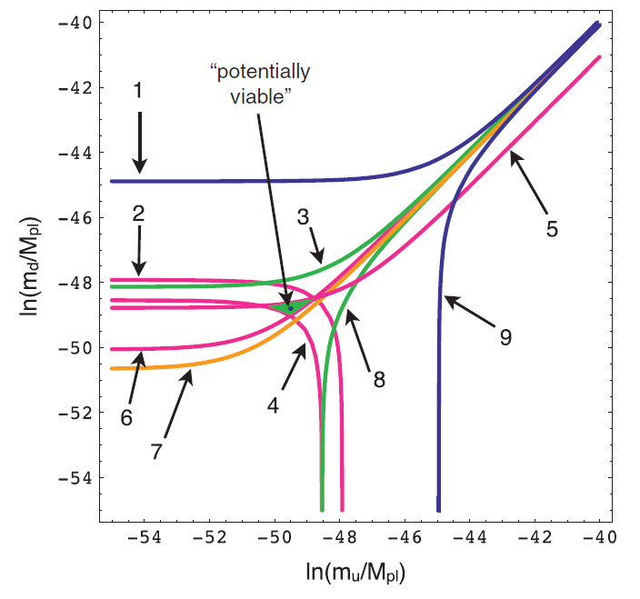
Barnes writes that Stenger got most of the science wrong in both his book and the MonkeyGod simulation. “Of all the ways that the laws of nature, constants of physics and initial conditions of the universe could have been, only a very small subset permits the existence of intelligent life”
Barnes models how changing the values of two constants impacts multiple life-permitting conditions. The resulting viable range of life permitting values of the two constants is smaller than anyone previously understood because the additional conditions “chip away” the larger area Stenger observed is permitted by just evaluating the outcome on one single condition.
In the above example, if only condition 1 is considered, and everything below 1 is life permitting, the area of life permitting variation in the constant values is quite large. But if the effects of conditions 2 through 9 are added in, the life permitting range of the constant values gets very small.
The implications are not only that Stenger is wildly wrong, but the original formulations of fine-tuning may have overstated the ability of random selection of the values of the constants being viable, making the case for fine tuning even stronger than previously thought.
Like Stenger, Barnes varies the value of two constants at once. In this case it is the mass of up and down quarks.
Unlike Stenger, Barnes evaluates many life-permitting conditions at once, instead of just one as Stenger modeled. (See next slide for the list of conditions.)
Constant values above the line for Condition 6 are life permitting, values below Condition 5 are life permitting, values to the left of Condition 2 are life permitting, values to the right of Condition 4 are life permitting.
The resulting life permitting space is very tiny, much smaller than Stenger’s wedge, even smaller than previous calculations by Christian apologists.

Slide 35
Explanation of the life-permitting conditions Barnes modeled in the previous slide
Above the blue line, only one element can exist, with the chemistry of helium
Above the red line, deuteron in unstable, preventing hydrogen burning in stars
Above the green line, neutrons decay so hydrogen is the only element in the universe
Below the red line, diprotons are stable and two protons can fuse into helium in a too fast process for stellar fusion
Above the red line, the production of deuterium in stars absorbs energy rather than releasing it and deuterium is unstable, prohibiting stellar formation
Below the red line a proton in a nucleus can capture an electron and become a neutron, making atoms unstable
Below the orange line, isolated protons are unstable, leaving no hydrogen left over from the early universe
Below the green line, protons in nuclei decay, so that any atoms formed would disintegrate into a cloud of neutrons
Below the blue line, the only stable element consists of a single particle, which can combine with a positron to produce an element with the chemistry of hydrogen, permitting the only molecules to form to be similar to H₂
The above and the charts for Stenger’s Wedge and Barnes’ nine condition analysis are taken from Luke Barnes’ paper The Fine Tuning of the Universe for Intelligent Life

Slide 36
Stenger issued a 12-page rebuttal to Barnes, sort of
Stenger said:
“Barnes makes his usual objections to my admitted oversimplifications. Does he really expect me to simulate entire universes?”
David answering here instead of Barnes:
“Uh, yes, if you expect me to change my religious beliefs on the basis of your model’s results you had better do the best job possible.”
One science commentator said that he wasn’t sure if Stenger or Barnes were right until he read Stenger’s rebuttal; the rebuttal convinced him Barnes was right

Slide 37
Dreams of a final theory
The second objection to fine tuning is the hope a future theory will provide a means to derive the physical constants as having as necessary values
This was an explicit hope of Einstein, and he devoted the last decades of his life to the search for such a theory
In 1991, Steven Weinberg (who had won the Nobel prize for uniting the weak and electromagnetic forces) wrote Dreams of a Final Theory in which he laid out the features that a final theory would by necessity have
Fast forward 20 years to 2009, in his collection of essays Lake Views Weinberg has abandoned all hope of a final theory with this astonishing statement in a chapter named “Can Science Explain Everything? Anything?”
“Finally, it seems clear that we will never be able to explain our most fundamental scientific principles.”

Slide 38
Stanford Encyclopedia of Philosophy’s on the theory of everything
“Einstein’s idea is that, ultimately, the laws and constants of physics will turn out to be dictated completely by fundamental general principles. This would make considerations about alternative laws and constants obsolete, and thereby undermine any perspective according to which these are fine-tuned for life.
“Unfortunately, developments in the last few decades have not been kind to hopes of the sort expressed by Einstein. In the eyes of many physicists, string theory is still the most promising candidate “theory of everything” in that it potentially offers a unified account of all known forces of nature, including gravity. … But according to our present understanding of string theory, the theory has an enormous number of lowest energy states, or vacua, which would manifest themselves at the empirical level in terms of radically different effective physical laws and different values of the constants.
“These would be the laws and constants that we have empirical access to, and so string theory would not come close to uniquely determining the laws and constants in the manner envisaged by Einstein.”
In other words, the large number of solutions to the string equations do not suggest a physical process by which fundamental laws of physics can set the constants to the fine-tuned values we observe

Slide 39

In the fine-tuning debate, all roads lead to the multiverse
There are many versions of the multiverse, but we will restrict our discussion to a “Level 2” which is the most common way the term is used
A Level 2 multiverse has an eternally inflating overarching cosmos from which an infinite number of “bubble” or “island” universes condense in local big bangs
The local bubble universes might have different physical laws and physical constants chosen randomly perhaps as random solutions to the string equations
It can be argued that a Level 2 multiverse is the version that defeats the Fine-Tuning Argument
An infinite number of rolls of the dice is sometimes taken to mean that every possible combination of the physical constants will be realized
Joined with the Weak Anthropic Principle, our universe is explained as nothing more than a chance event of the type where observers will evolve to wonder about it

Slide 40
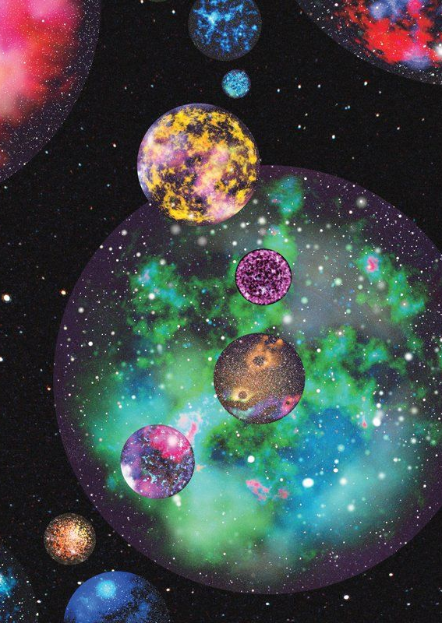
A Level 2 multiverse is by far the cosmology favored by most atheist physicists today
Steven Weinberg
Matin Rees
Sean Carroll
Lee Smolin
Alan Guth
Brian Greene
Lawrence Kraus
Max Tegmark
And this is the perfect segue to one of my favorite observations by a renown physicist …

Slide 41
Physicist Bernard Carr’s summary of the Fine-Tuning debate
“If you don’t want God, you better have a multiverse.”

Slide 42

Flew discounted the multiverse as merely shifting the problem up one level
Flew wrote:
“This fine tuning has been explained in two ways. Some scientists have said the fine tuning is evidence for divine design; many others have speculated that our universe is one of multiple others—a “multiverse”—with the difference that ours happened to have the right conditions for life…
“What is especially important here is the fact that the existence of a multiverse does not explain the origin of the laws of nature. …
“If there is a ‘law of laws’ describing how parameter values are assigned as one slips from one universe to the next, then we have only shifted the problem of cosmic biophilicity up one level. Why? First, because we need to explain where the law of laws comes from…”

Slide 43

We will leave the multiverse to another discussion, but a few quick observations
There are many competing models of cosmic inflation and the multiverse (literally hundreds), but all share these qualities
The multiverse is implied by the mathematics of inflation in the first microsecond of the universe, because once started, inflation may not stop – ever
If one bubble or island universe can condense out of the inflating totality, and clearly at least one has, there is no reason an infinite number would not condense out over an infinite future
A multiverse where each bubble has our values for the constants does not solve the fine-tuning problem - so one must hypothesize an unknown process for randomly generating the values
And such a multiverse process that randomly generates universes does not solve the fine-tuning problem either as that process would have to be fine-tuned itself (Antony Flew’s position) to occasionally produce a life-permitting universe
There is little, arguably no, direct evidence for the multiverse, nor will there ever be a large amount of evidence because all the other universes are beyond the light horizon of this universe
Using Karl Popper’s Falsification Principle, the existence of other universes is not falsifiable because even if they are there, we can’t detect them, so speculating on them is arguably metaphysics or religion - not science
Some observers have commented that the multiverse may represent the end of science because it is pointless to study physical laws set by an ultimately random process

Slide 44
The most distressing statement by a physicist I have read
“Many scientists today, especially young scientists, are deeply invested in trying to prove a particular theory. If we reach an era where acquiring experimental evidence to do so for inflation is forever beyond our technological reach, then other means – including social proof in the form of expert consensus - could become part of how scientific consensus is reached about such theories. In the post-Popper era, as unpalatable as it may be, social proof without experimental falsification may become the norm.”
Brian Keating, Professor of physics at the University of California, San Diego, “How Did It All Begin, Cosmic Inflation, the Multiverse, and the Nature of Scientific Proof,” Skeptic magazine, Vol. 26 No.1 2021
Social proof handed down by an insular club of self-referencing experts? Really? Knowledge not based on experimental evidence? Isn’t this the end of scientific method - a philosophy that has driven all human scientific progress to date? Can anyone believe science will continue to progress with such a process as social proof in the future?

Slide 45
Interesting aside
Physicist Sabine Hossenfelder, an atheist herself, states in a YouTube video debate with Luke Barnes that in her experience scientists that believe in God are more careful keeping their metaphysical [religious] beliefs out of their work than atheist scientists are.

Slide 46
Summarizing
The mathematics of the physical constants suggest that our universe extraordinarily fine-tuned for life
This is debated by few first-rank scientists and those that do debate it, like Victor Stenger, may be on shaky ground scientifically speaking, as demonstrated by Luke Barnes
One possibility is that a final theory of everything will reveal a process by which the constants must be what they are – but the chances of this are receding in the eyes of leading physicists
Another possibility is that we inhabit a local bubble, or island, universe in an infinite multiverse, with each bubble having the values of its constants randomly determined as solutions to the string equations by some unknown process – and we just happen to live in one where chance produced life-friendly values
There is virtually no evidence for a multiverse, nor can there ever be, so believing in the multiverse can be thought of as an act of religious faith or of social proof rather than of scientific discovery
Without the multiverse, the fine-tuning argument supports belief in an intelligent creator that wanted a universe with life
And arguably it does even with a multiverse

Slide 47
Maybe we should let our modern philosopher, Brandi Carlile, have the very last say
Have you ever wandered lonely through the woods? And everything there feels just as it should You're part of the life there You're part of something good If you've ever wandered lonely through the woods
https://youtu.be/FkxyT27xRH0

Slide 48
Discussion questions
How important is the origin and evolution of the physical universe to any aspect of your faith?
Many Christians take comfort in the fine-tuning argument, others don’t really care.
Where do you come out?
Are you concerned at all about the nature and content of the popular media discourse on cosmic origins which is universally hostile to theism?
Many Christian apologetic leaders feel that fine tuning addresses the public impression that scientifically based atheism explains everything in terms of cosmic origins.
Is this public discourse on fine tuning important and are the apologetics’ arguments convincing?
Should Christian leaders take such a stand in favor of fine tuning?

Slide 49
Recommended
Fine Tuning
Just Six Numbers by Martin Rees, a classic in the field, somewhat technical at times, by an atheist physicist.
The Goldilocks Enigma by Paul Davies, an enjoyable read, well written, by a physicist who believes the universe has a “shadowy” teleological principle driving it. The book is not technical and easy to understand as he tours the fine-tuning and cosmological landscape. A really must read.
The Fallacy of Fine-Tuning by Victor Stenger, discussed in this presentation.
A Fortunate Universe by Luke Barnes and Geraint Lewis, discussed in this presentation. A must read. Lewis is an atheist and while he and Barnes agree on the science, they disagree on the meaning of the science. Nicely balanced which helps the reader choose an interpretation without worrying about a biased presentation of facts.
There Is a God by Anthony Flew, discussed in this presentation.
A Defense of the Integrity of Antony Flew’s “There is a God” From His Own Letters by Anthony Horvath.
https://plato.stanford.edu/entries/fine-tuning/ for the Stanford Encyclopedia of Philosophy entry on fine tuning. A good read and surprisingly even-handed given it is produced in “enemy territory” as far as the faith goes.
“The Fine Tuning of the Universe for Intelligent Life,” Publications of the Astronomical Society of Australia, Cambridge University Press, January 2013, by Luke Barnes: https://arxiv.org/abs/1112.4647 . This is a short article-length version of his book and has an excellent technical discussion that is easier to follow than the one in the book because of its focus. This article is the source of the diagrams of Stenger’s wedge and Barnes nine condition analysis. I recommend you start with this article, then read the book.
Videos featuring Luke Barnes: https://www.closertotruth.com/search/site/luke%20barnes
Debate between Antony Flew and William Lane Craig in 1998 with Flew taking the atheist viewpoint: https://youtu.be/NixhL0CoH2s
Debate between Luke Barnes and Sabine Hossenfelder on YouTube: https://youtu.be/5OoYzcxzvvM. Hossenfelder argues we should not consider alternative values of the constants because we have no way to know if they can have different values. She basically rejects the idea that they were randomly set by God or string theory. She believes the question is unanswerable and therefore fine tuning is not a scientific question. She is a purest and has no curiosity about non-scientific questions such as the purpose of life. While articulate, admirable, and consistent (she also considers string theory and the multiverse as non-scientific), she demonstrates the extreme mindset one must have to dismiss fine tuning and the value of investigating the ultimate questions. Barnes comes across as intelligent and friendly, and he holds his ground on the purely scientific questions.
Wikipedia definition of naturalness: https://en.wikipedia.org/wiki/Naturalness_(physics)
Multiverse
Worlds Without End by Mary-Jane Rubenstein, a delightful book that is fun to read and a comprehensive discussion of the multiverse.
Who Is Afraid of the Multiverse by Jeffrey Zweerink, a straightforward, intelligent argument summarizing the case against the multiverse from a well-informed professional physicist who is a Christian apologetic affiliated with Reasons to Believe.
Not Even Wrong by Peter Woit, an indictment of String Theory and physics that have no hope of experimental confirmation. A physicist that acquired something like prophet status when he predicted the LHC would not find evidence for supersymmetry – and then it didn’t. Supersymmetry is a requirement of the multiverse and string theory.
Lost in Math by Sabine Hossenfelder, an indictment of modern physics that emphasizes mathematical beauty and consensus over experimental confirmation. A greatly entertaining read and a provocative thesis by a working physicist. Her YouTube vides series on physics and other topics is superb.
Brandi Carlile
“Have You Ever” https://youtu.be/FkxyT27xRH0

